Slide 1
Introducing Java
Course Code: CSC 1205
Course Title: Object Oriented Programming 1
Dept. of Computer Science
Faculty of Science and Technology
Lecturer No: | 1 | Week No: | 1 | Semester: | Summer 19-20
Lecturer:

Slide 2
Lecture Outline
History of Programming Languages
Importance of OOP
Java as OOP Language
JVM Architecture
Hello World Program

Slide 3
History of Programming Languages
What is Programming Language
“Instead of imagining that our main task is to instruct a computer what to do, let us concentrate rather on explaining to human beings what we want a computer to do.” - Donald Knuth
A programming language is an artificial language that can be used to control the behavior of a machine, particularly a computer. Programming languages, like human languages, are defined using syntactic and semantic rules, to determine structure and meaning, respectively.

Slide 4
History of Programming Languages
Evolution of Programming Languages
Epoch | Description | Languages
1950’s | Creation of high-level languages | Assembly, Fortran
1960’s | Expansion of specialized languages | Simula, Lisp, Cobol
1970’s | Duel between structured programming with Pascal and efficiency of C language | C, Pascal
1980’s | Experimenting other ways including objects | Smalltalk, C++
1990’s | Generalization of object-oriented programming with the performance of microcomputers | Java, Perl, Python, PHP
2000’s | Internet Programming | C#, Scala
2010’s | Concurrency and asynchronicity | JavaScript, Go

Slide 5
History of Programming Languages
The Creation of Java
Java was conceived by James Gosling, Patrick Naughton, Chris Warth, Ed Frank, and Mike Sheridan at Sun Microsystems, Inc. in 1991.
It took 18 months to develop the first working version.
This language was initially called Oak but was renamed Java in 1995.
The primary motivation was the need for a platform-independent language, not the internet.

Slide 6
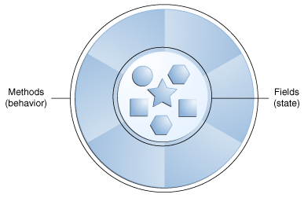
Importance of OOP
What is an Object
Objects are key to understanding object-oriented technology.
Real-world objects share two characteristics: They all have state and behavior.
Example:
  Dogs have state (name, color, breed, hungry) and behavior (barking, fetching, wagging tail)
  Bicycles also have state (current gear, current pedal cadence, current speed) and behavior (changing gear, changing pedal cadence, applying brakes)

Slide 7
Importance of OOP
What is OOP
Object Oriented Programming (OOP) is a programming methodology that helps organize complex programs using inheritance, encapsulation, and polymorphism.

Slide 8
Importance of OOP
Why OOP
Throughout the history of programming, the increasing complexity of programs has driven the need for better ways to manage complexity.
Object Oriented Programming (OOP) was developed as there were limitations in earlier approaches.
Process-oriented model was one of the earlier approaches to Object-oriented programming
To clearly understand the importance of object-oriented programming, we need to know about the process-oriented model

Slide 9
Importance of OOP
Why OOP (Process-Oriented Model)
All computer programs consists of two elements: a) code (what is happening) b) data (who is being affected)
Process-Oriented Model:
This approach characterizes a program as a series of linear steps (that is, code).
In this model, programs are typically organized around code. This approach can be thought of as code acting on data.
Procedural languages such as C employ this model to considerable success.
In procedural programming, program is divided into small parts called functions.
Procedural programming follows top down approach.
In procedural programming, function is more important than data.

Slide 10
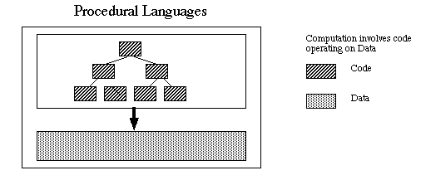
Importance of OOP
Why OOP (Process-Oriented Model)
In multi-function program, important data items are placed as global so that they may be accessed by all functions
Procedural programming is based on unreal world.

Slide 11
Importance of OOP
Why OOP (Drawbacks of Process-Oriented Model)
Problems with this approach appear as programs grow larger and more complex.
As function has complete access to the global variables, it is possible that new programmer can corrupt the data accidentally by creating functions.
Data is exposed to whole program, so no security for data.
In large program it is very difficult to identify what data is used by which function.
Difficult to relate with real world objects.
Difficult to create new data types reduces extensibility.
Importance is given to the operation on data rather that the data.

Slide 12
Importance of OOP
Why OOP (Object-Oriented Programming)
Object-oriented programming organizes a program around its data (that is, objects) and a set of well-defined interfaces to that data.
An object-oriented program can be characterized as data controlling access to code.
In OOP, problem is divided into the number of entities called objects and then builds data and methods around these objects.
It binds the data more closely to the method that operate on it and protects it from accidental modification.
Data of an object can be accessed only by the methods associated with the object.
Follows bottom up approach.
Increases code reusability and maintainability.

Slide 13
Importance of OOP
Why OOP is Important
Modularity for easier troubleshooting.
Reuse of code through inheritance.
Flexibility through polymorphism.
Effective problem solving.

Slide 14
Java as OOP Language
Why Java is Object Oriented
It is not possible to code in java without class and object. Even to write a single hello world program, we need to declare a class.
Java supports encapsulation.
Java supports abstraction.
Java supports inheritance.
Java supports polymorphism.

Slide 15
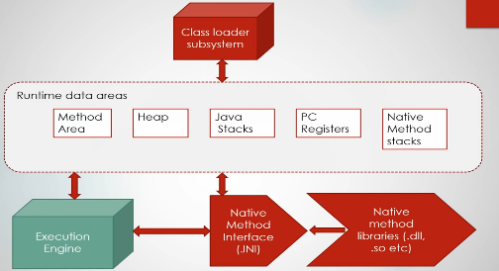
JVM Architecture
Introduction to JVM
JVM(Java Virtual Machine) acts as a run-time engine to run Java applications.
It converts Java bytecode into machines language
JVM is a part of JRE(Java Runtime Environment).

Slide 16
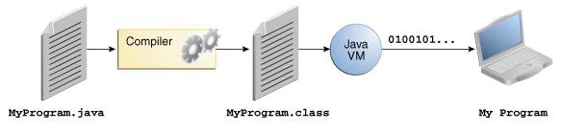
JVM Architecture
How JVM Works
In the Java programming language, all source code is first written in plain text files ending with the .java extension.
Those source files are then compiled into .class files by the javac compiler.
A .class file does not contain code that is native to your processor; it instead contains bytecodes—the machine language of the Java Virtual Machine (Java VM).
The java launcher tool then runs application with an instance of the Java Virtual Machine.

Slide 17
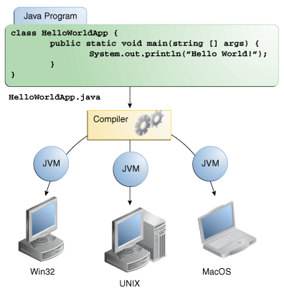
JVM Architecture
Why Java is Platform Independent
The meaning of platform-independent is that the java compiled code(byte code) can run on all operating systems.
The Java VM is available on many different operating systems.
As a result, the same .class files can run on Microsoft Windows, Linux, Mac OS and so on.

Slide 18
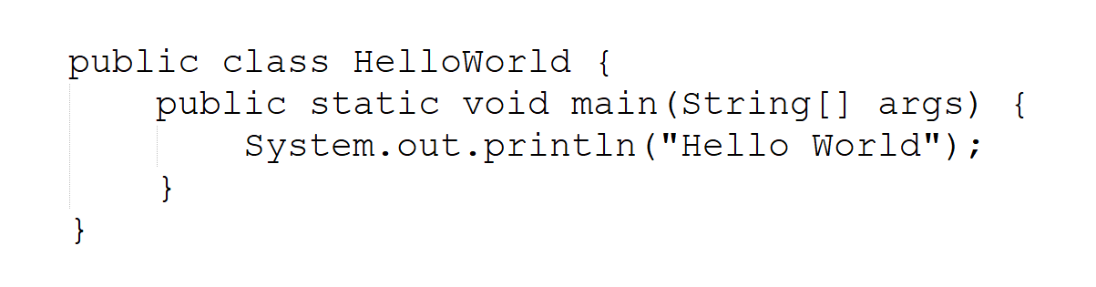
Hello World Program
Basic Hello World Program
Create a HelloWorld.java source file.
Write the following code in the source file.

Slide 19
Hello World Program
How to Execute Hello World Program
To compile HelloWorld.java, use the compiler. If successful, it will produce a file called HelloWorld.class in the same directory.
> javac HelloWorld.java
To execute, run the Java VM and include the name of the class which contains the "main" method as the first command line parameter.
> java HelloWorld

Slide 20
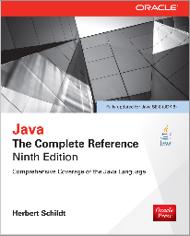
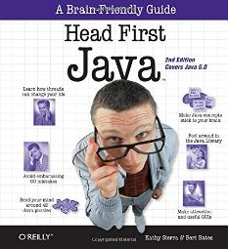
Books
Java The Complete Reference- Ninth Edition by Herbert Schildt
Head First Java, By Kathy Sierra and Bert Bates

Slide 21
References
https://www.cs.mcgill.ca/~rwest/wikispeedia/wpcd/wp/p/Programming_language.htm
https://www.scriptol.com/programming/history.php
https://docs.oracle.com/javase/tutorial/

